Slide 1
Rotary Phase Converter Upgrade
Steven Vokoun
EEL4930 Final Project Presentation

Slide 2
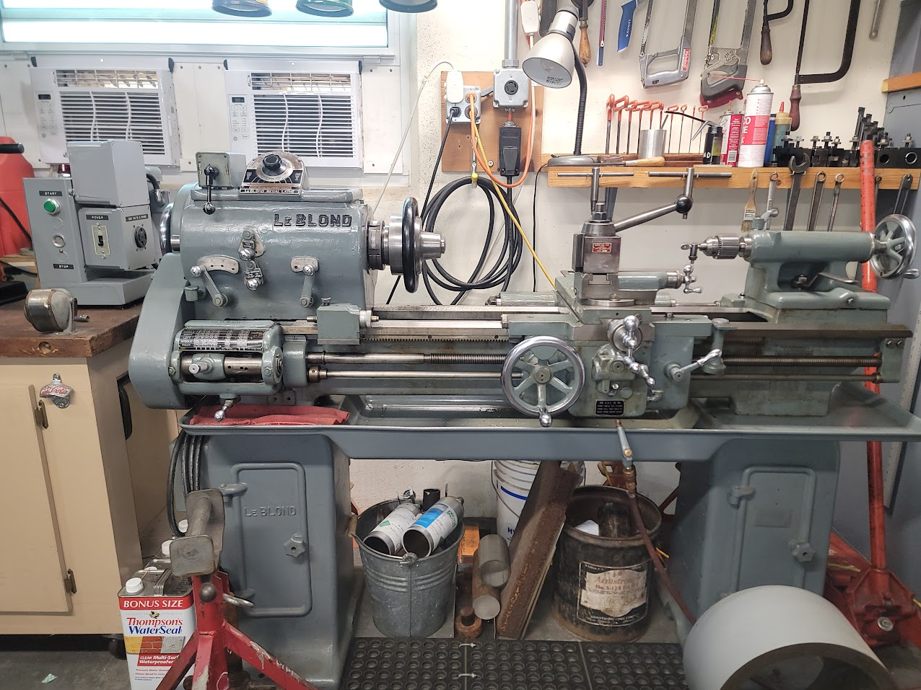
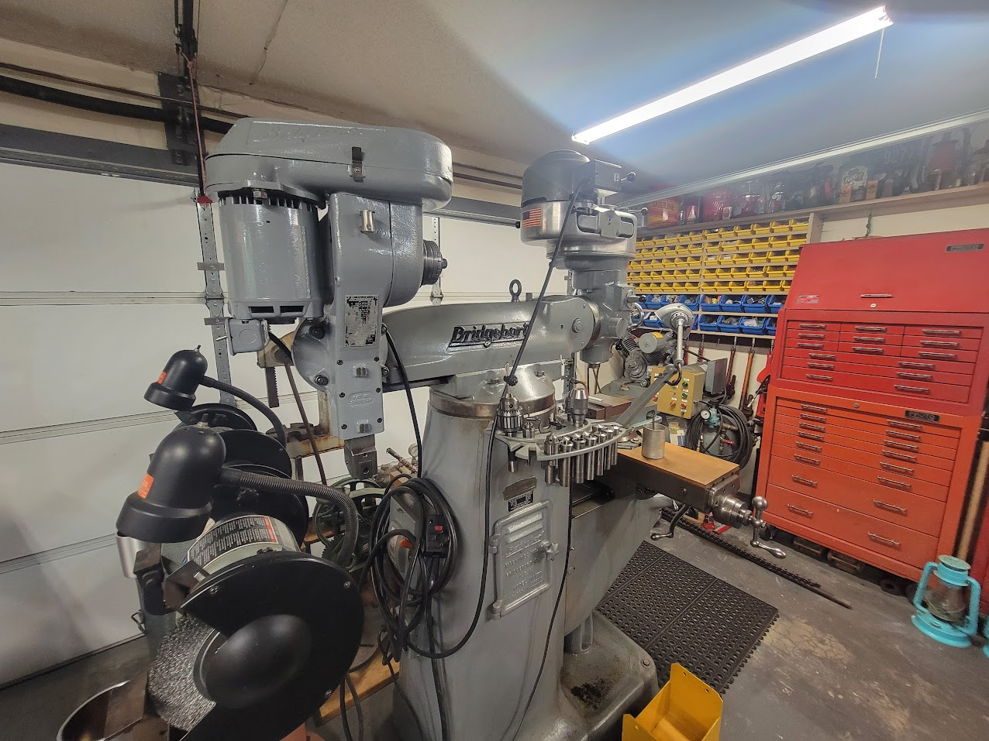
Motivation and Background
Hobby level machinists, woodworkers, and other specialties own three phase delta connected equipment
Cheaper second hand
More reliable
United States residential areas is typically singe-split phase power
Two 120V lines separated by 180 degrees

Slide 3
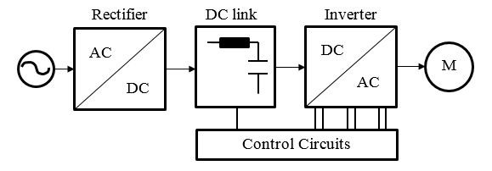
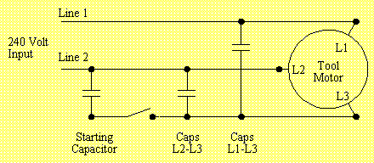
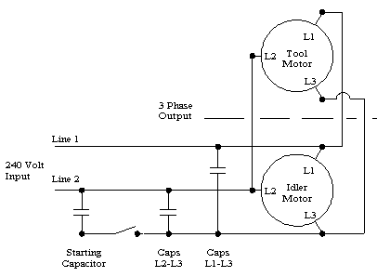
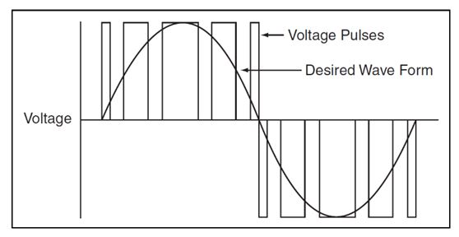
Choices For Phase Conversion
VFD
Static
Rotary
J. Ali Et. Al., “Design and Implementation of a Musical Water Fountain Based on Sound Harmonics Using IIR Filters,” IJCDS, vol. 9, no. 2, pp. 319–333, Jan. 2020, doi: 10.12785/ijcds/090217.
Waterfront Woods
Approximates three-phase using PWM signals
Known as “Single Phasing” a three-phase motor
Once you get is started via a starting capacitor or mechanical motion, can run on single phase itself
Waterfront Woods
Adds an additional motor in the mix
Single phases a “Idler Motor”, which in turn can power the Tool Motor off its generated third leg
vfd-softstarter.com

Slide 4

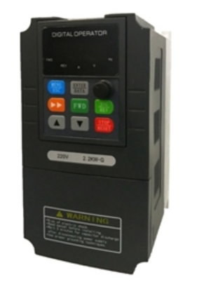
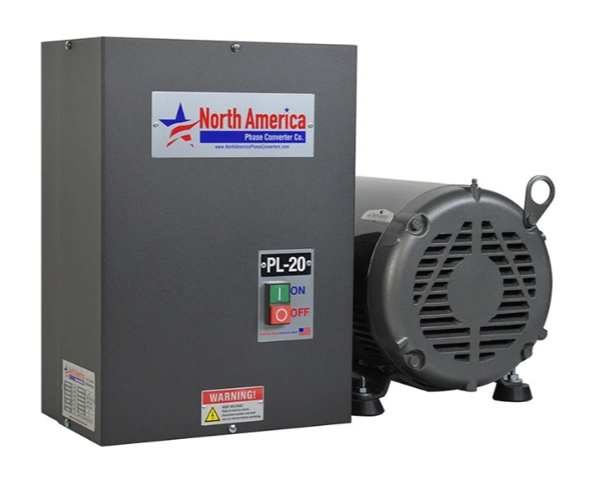
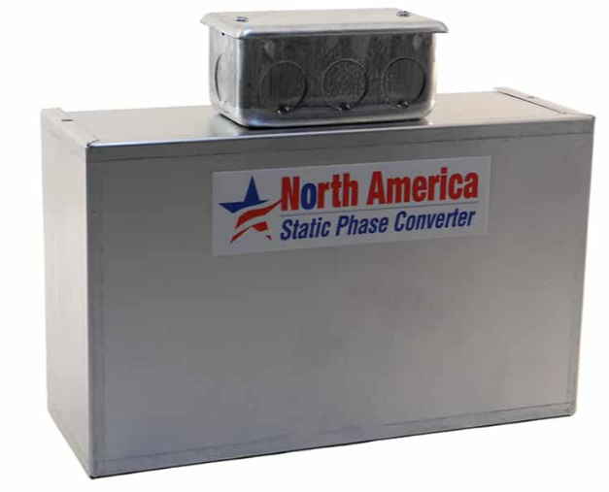
Choices For Phase Conversion
VFD
Static
Rotary
Medium cost (200$)
Needs a separate VFD for every motor in a shop (custom configured settings per motor)
Gives advanced start, stop, and speed control
Can not run CNC or electronics
Cheap ($150)
1/3 Drop in Maximum HP on the tool
Need a different converter for every motor HP (capacitors have to be resized)
For purely motor loads only (no CNC etc.)
Expensive ($1-2k)
Runs full tool HP
Can feed into a three-phase power panel to run a whole shop
Can run CNC and electronics
Draws Idle Power and is noisy
Focusing On Rotary!

Slide 5
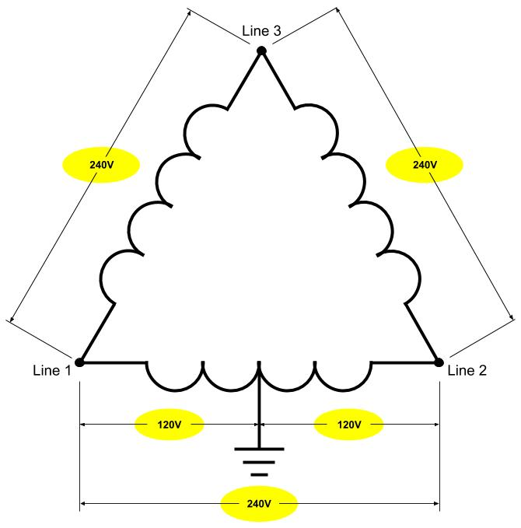
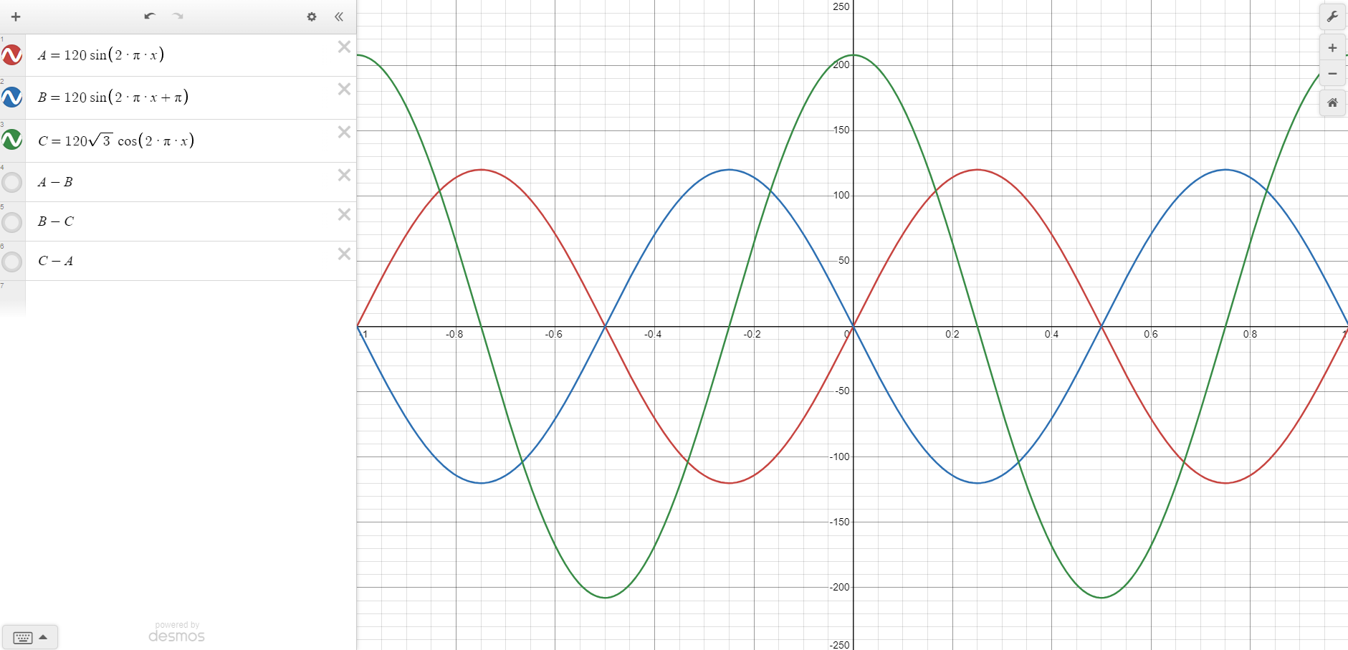
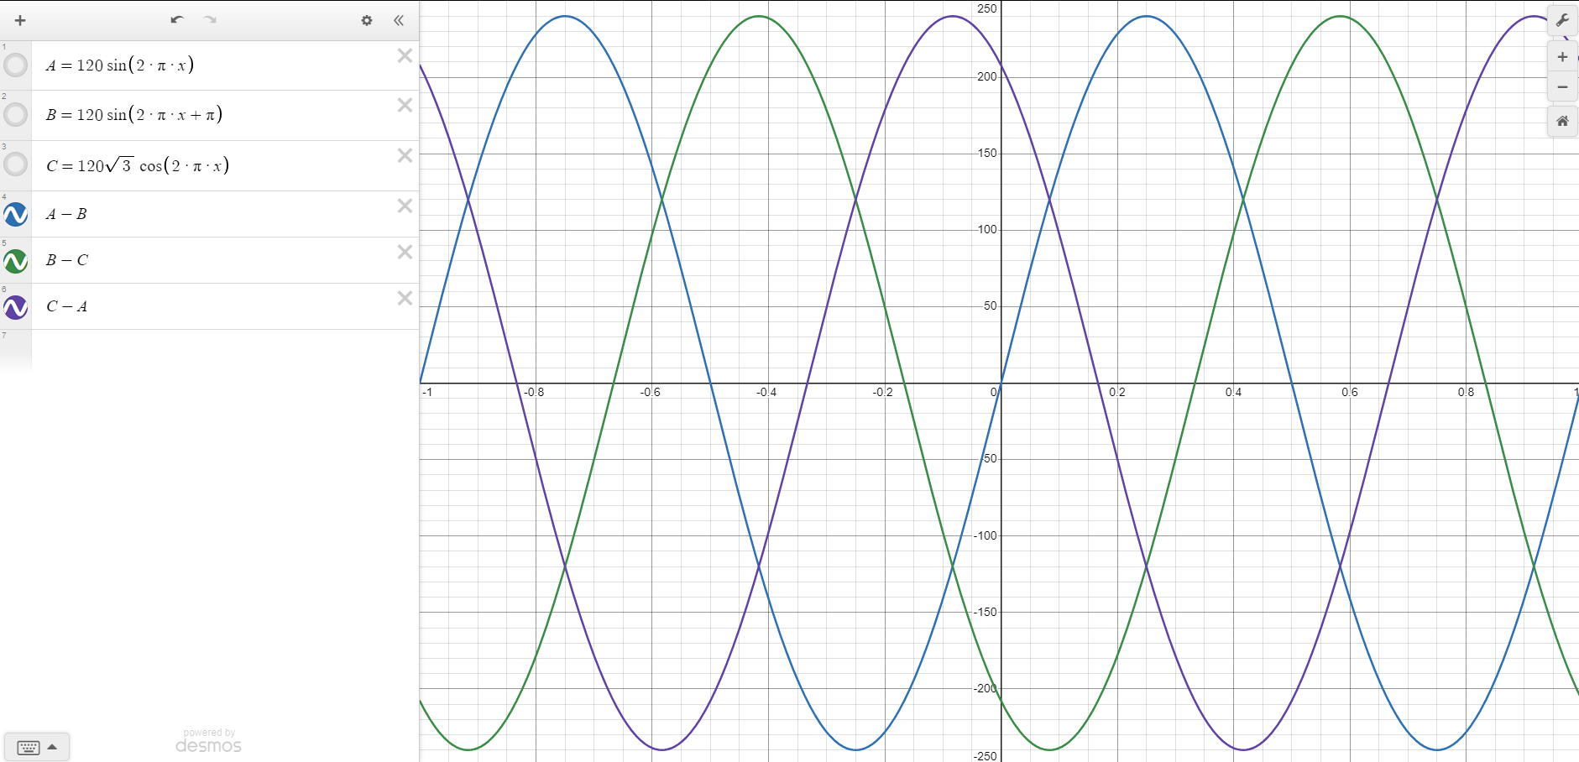
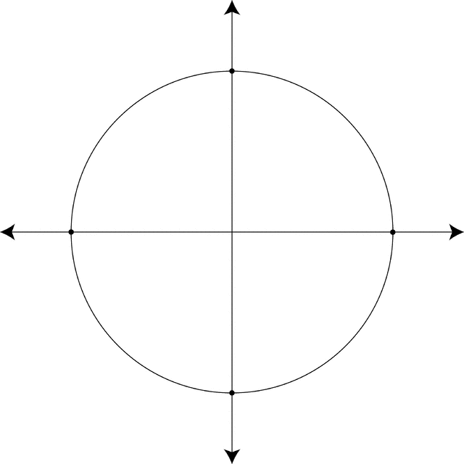
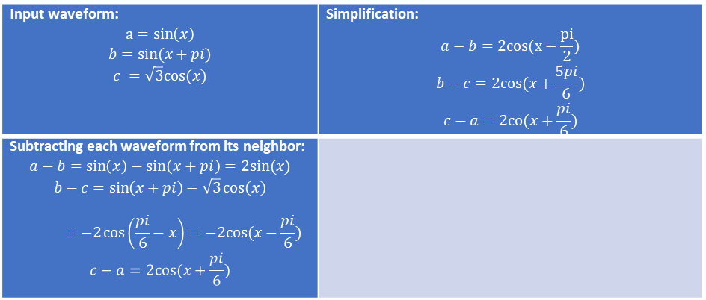
High Leg Delta Configuration
electram.com
Input waveform: $$a=sin\left(x\right)$$ $$b=sin(x+pi)$$ $$c =\sqrt{3}cos(x)$$ | Simplification: $$a−b=2cos(x−\frac{pi}{2})$$ $$b−c=2cos(x+\frac{5pi}{6})$$ $$c−a=2co(x+\frac{pi}{6})$$
Subtracting each waveform from its neighbor: $$a−b=\sin\left(x\right)−\sin\left(x+pi\right)=2sin⁡(x)$$ $$b−c=\sin\left(x+pi\right)−\sqrt{3}\cos\left(x\right)$$ $$=−2\cos\left(\frac{pi}{6}−x\right)=−2cos(x−\frac{pi}{6})$$ $$c−a=2cos(x+\frac{pi}{6})$$

Slide 6
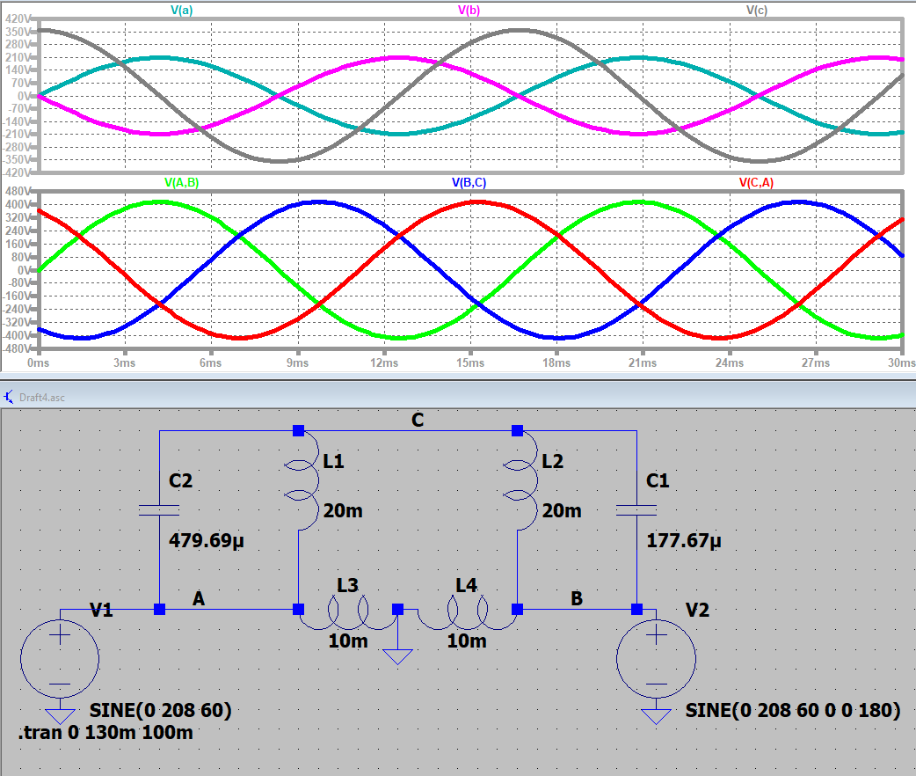
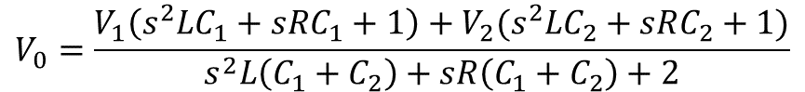
How To Get This Mathematically
$$V_{0}=\frac{V_{1}\left(s^{2}LC_{1}+sRC_{1}+1\right)+V_{2}(s^{2}LC_{2}+sRC_{2}+1)}{s^{2}L\left(C_{1}+C_{2}\right)+sR\left(C_{1}+C_{2}\right)+2}$$
Code:
%Constants
V1 = 120*sqrt(2);
V2 = -120*sqrt(2);
w = 2 * pi * 60;
s = w * 1j;
R = 2;
L = 20E-3;
desired_H = 120*sqrt(3)*sqrt(2) * exp(1j * 90 * pi/180);
%Transfer Function
numerator = V1*((s*C1) + (1/((s*L)+R))) + V2*((s*C2) + (1/((s*L)+R)));
denominator = (s*C1) + (2/((s*L)+R)) + (s*C2);
H = numerator/denominator;
%Fitting
eq1 = real(H) == real(desired_H);
eq2 = imag(H) == imag(desired_H);
sol = vpasolve([eq1, eq2], [C1, C2], [0.0001, 0.0001]);
%Print
fprintf('C1 = %.2f µF\n', double(sol.C1) * 1e6);
fprintf('C2 = %.2f µF\n', double(sol.C2) * 1e6);
Output:
C1 = 479.69 µF
C2 = 177.67 µF

Slide 7
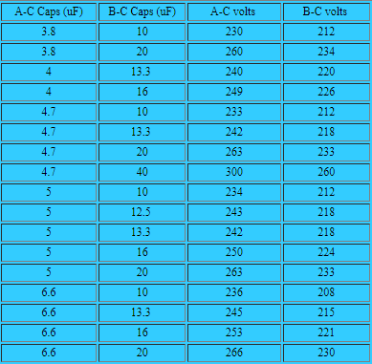
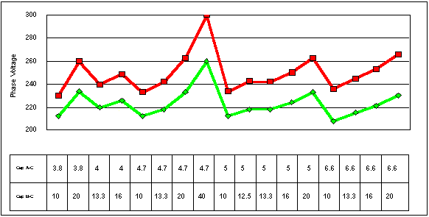
How It is Actually Found
Need LCR Meter to calculate properly
Calculations assumed each winding is exactly the same
Working with standard values of run caps
Waterfront Woods
Waterfront Woods

Slide 8
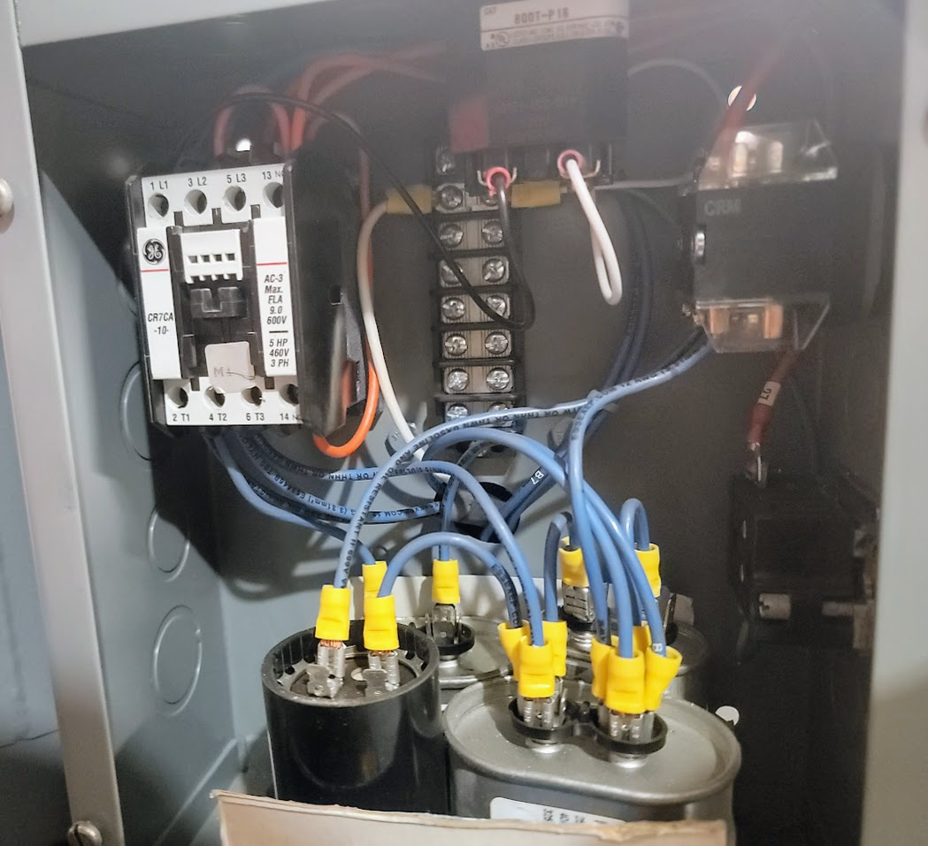
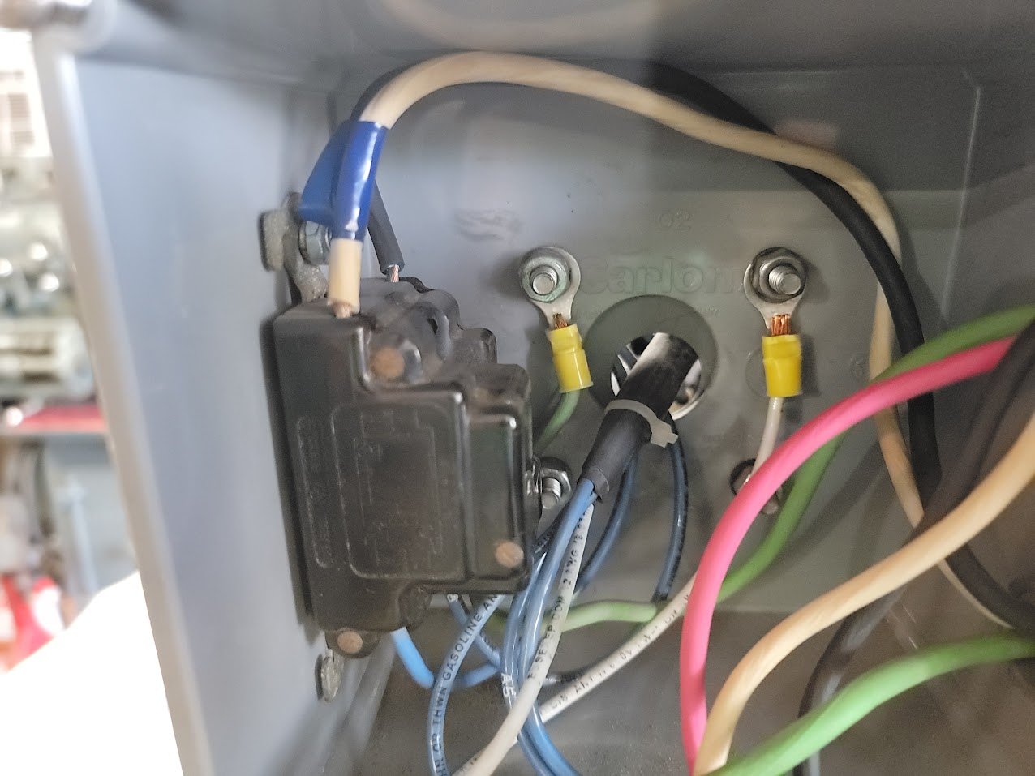
Goals for this Project
Add Auto Start Stop
Have single phase power on for lighting even when the converter is off
One button push start
Tune in the voltage and phase
Add a current meter

Slide 9
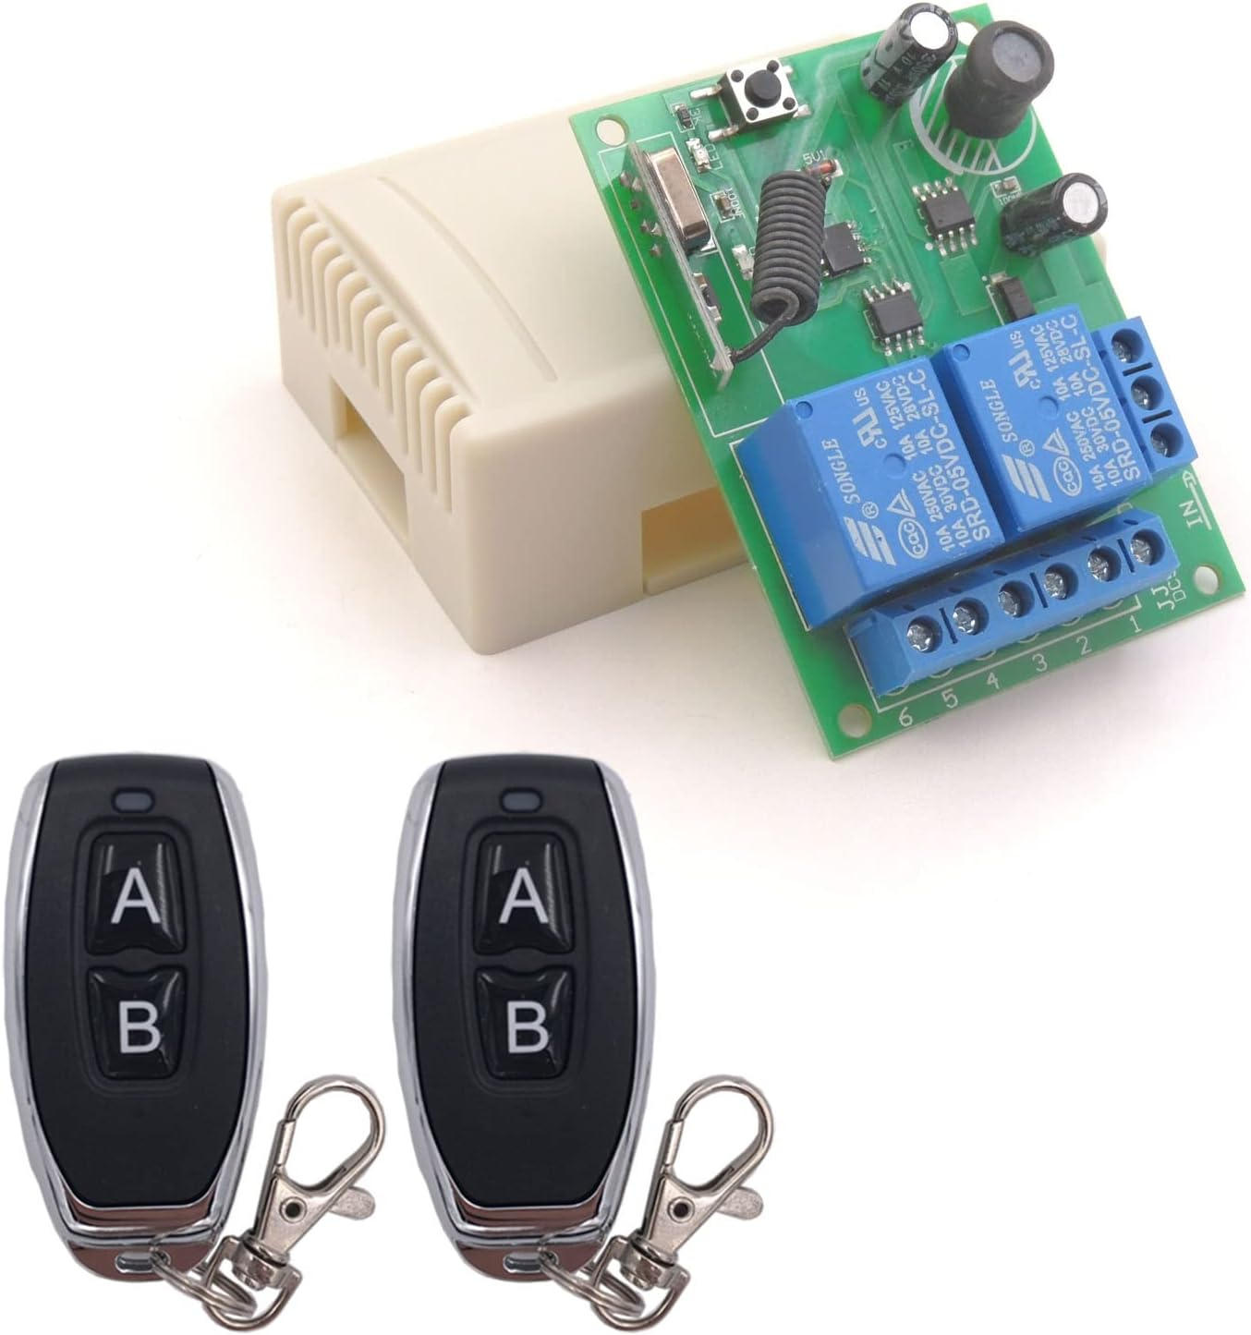
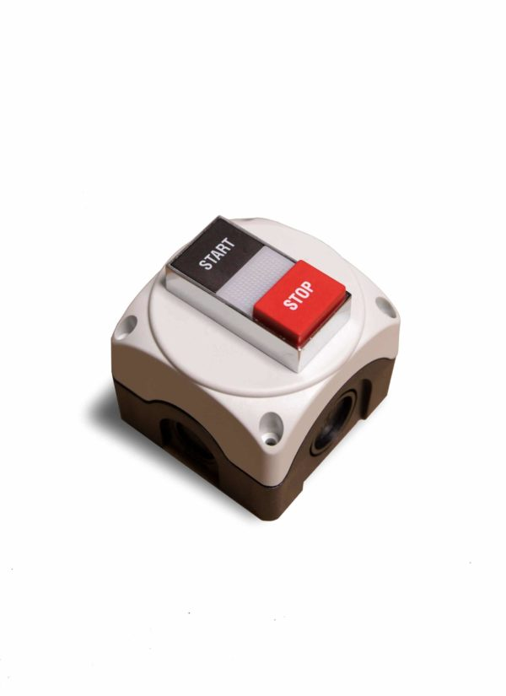
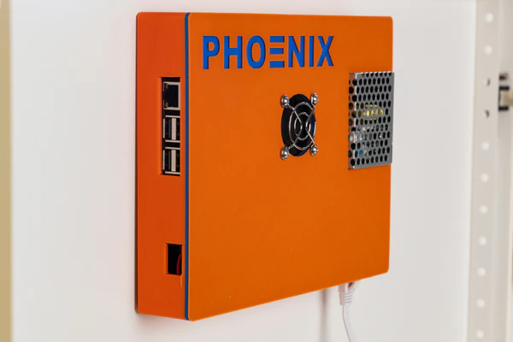
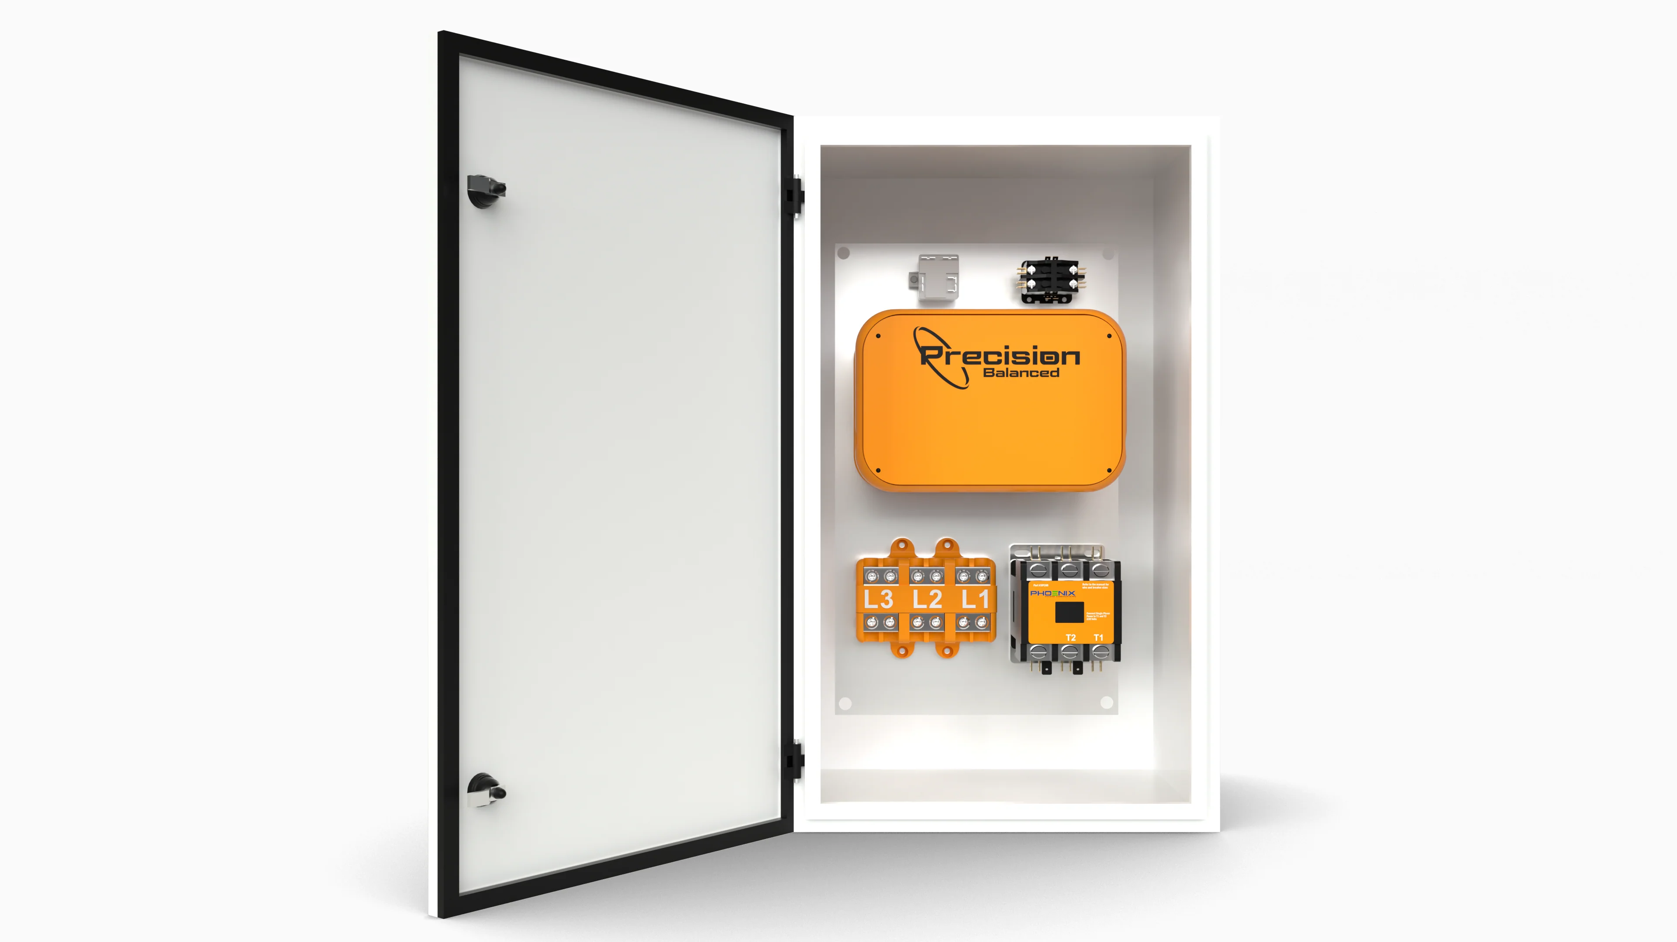
Current Solutions
Use a RF remote control connected to a relay in the converter
Place an additional wired switch next to each machine for the converter
Use a much larger start capacitor, and turn on both motors at the same time using a sense wire
Phoenix Phase Converters holds patent on similar solution to mine
Optional add on (doubles price of the standard model)
Company has poor reviews, questionable quality, loud undersized and too fast of motors, and is overpriced
Amazon.com
American Rotary
www.phoenixphaseconverters.com

Slide 10
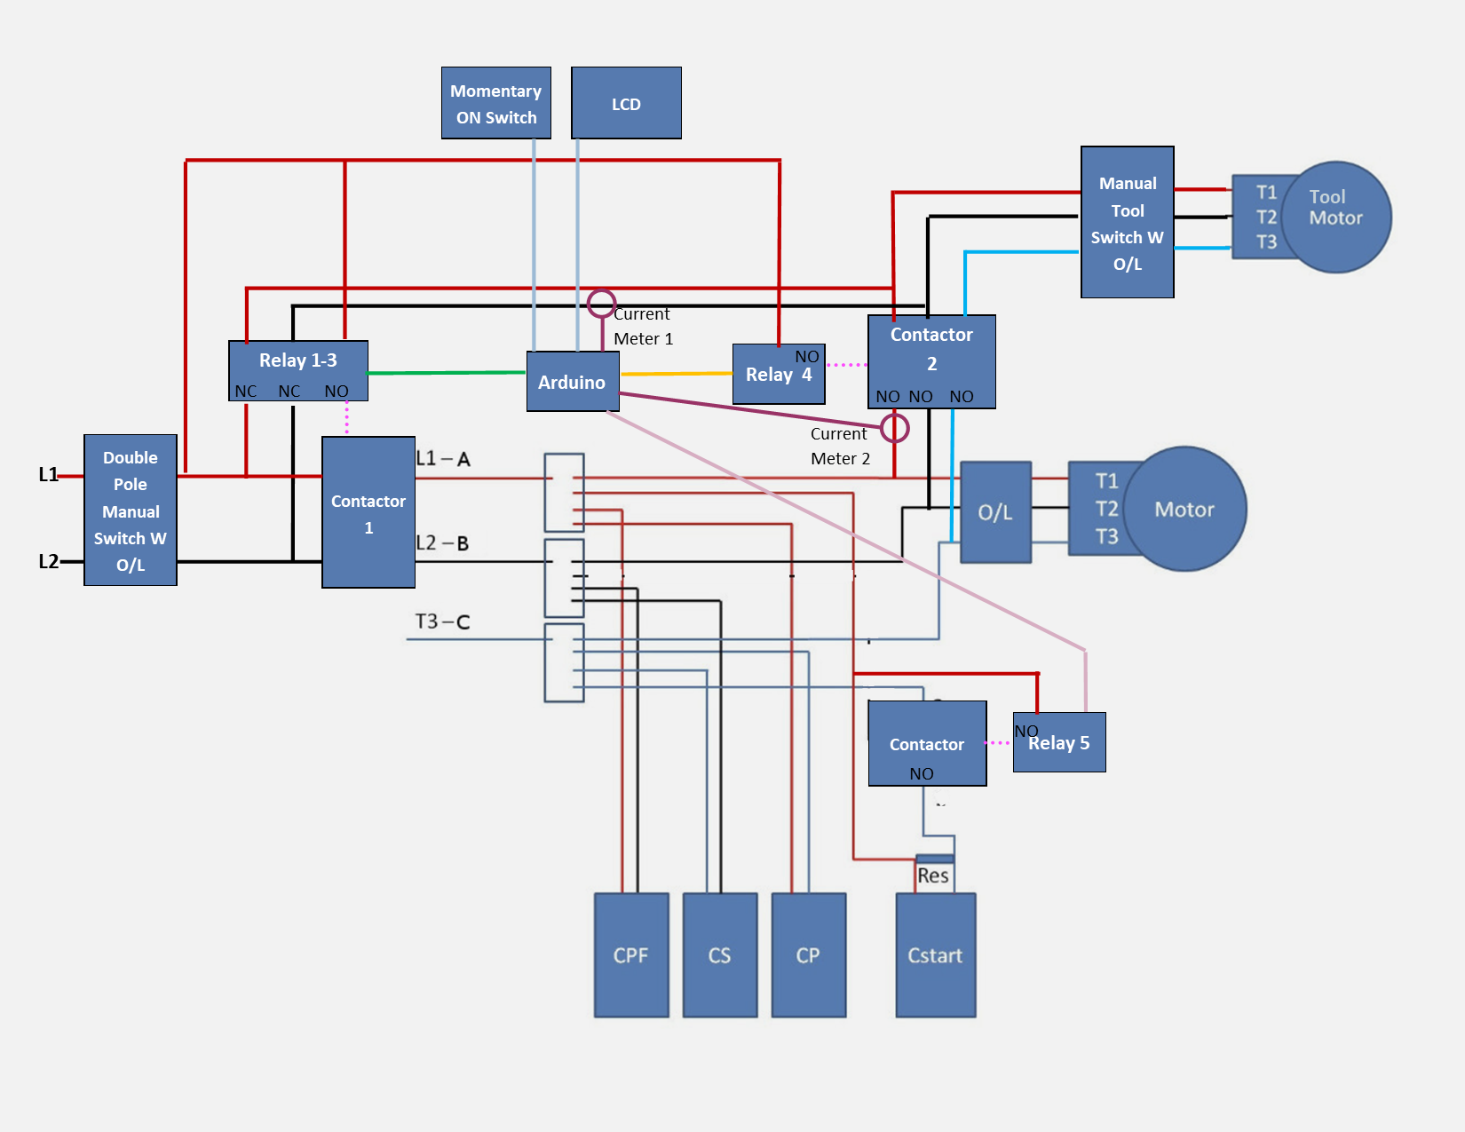
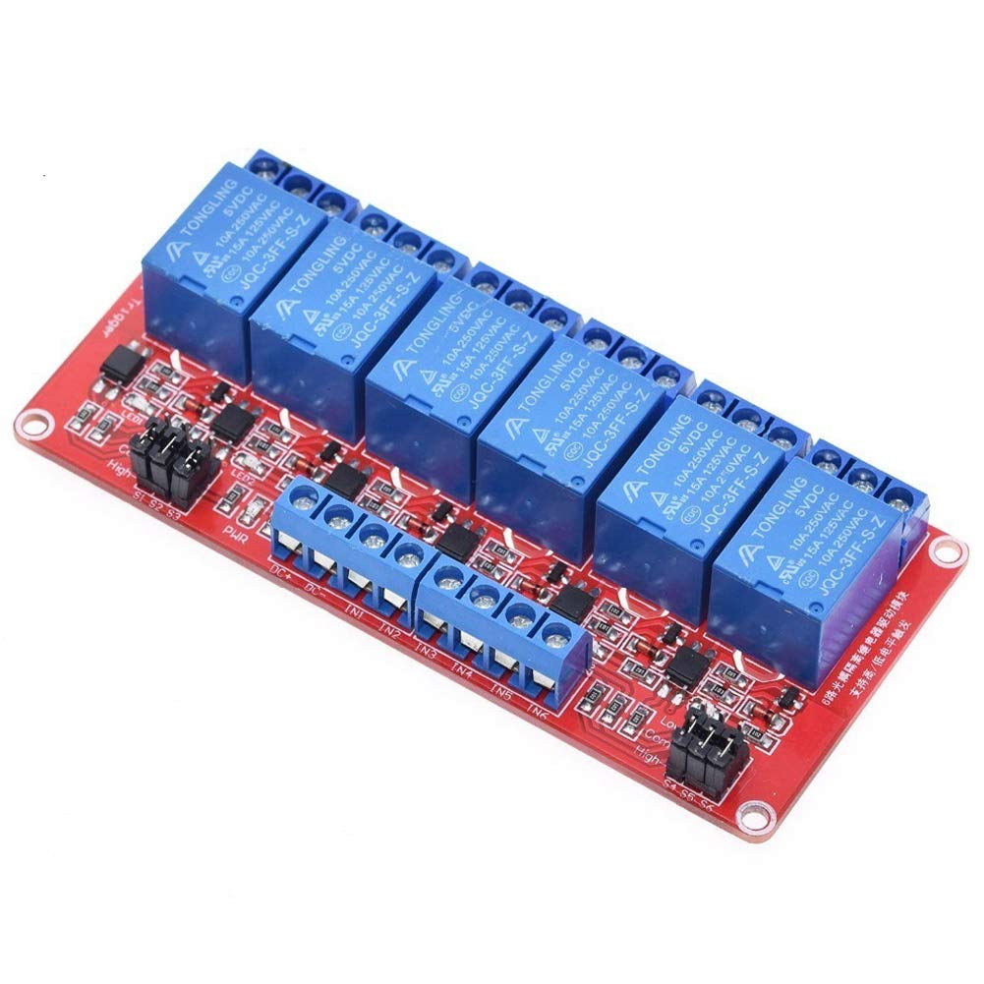
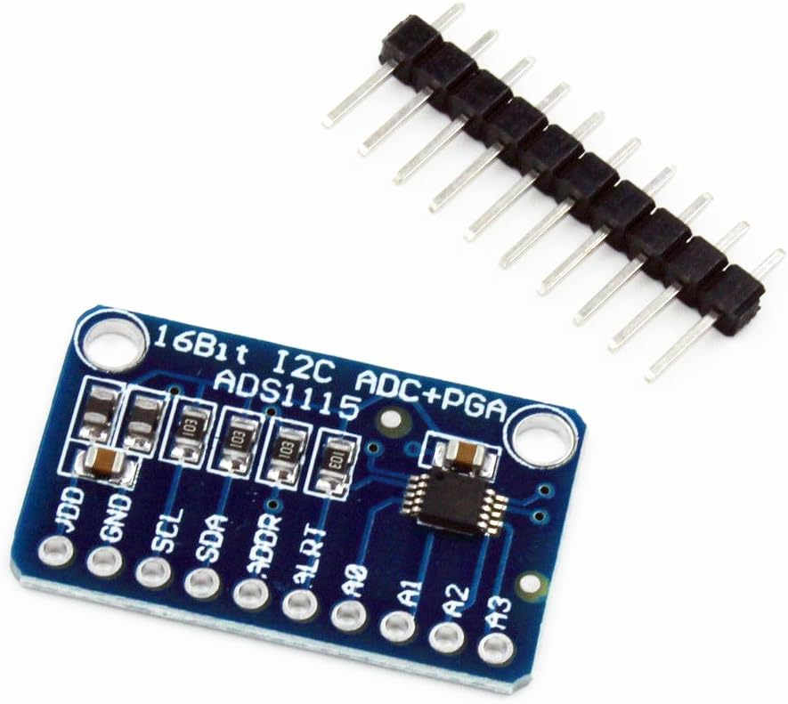
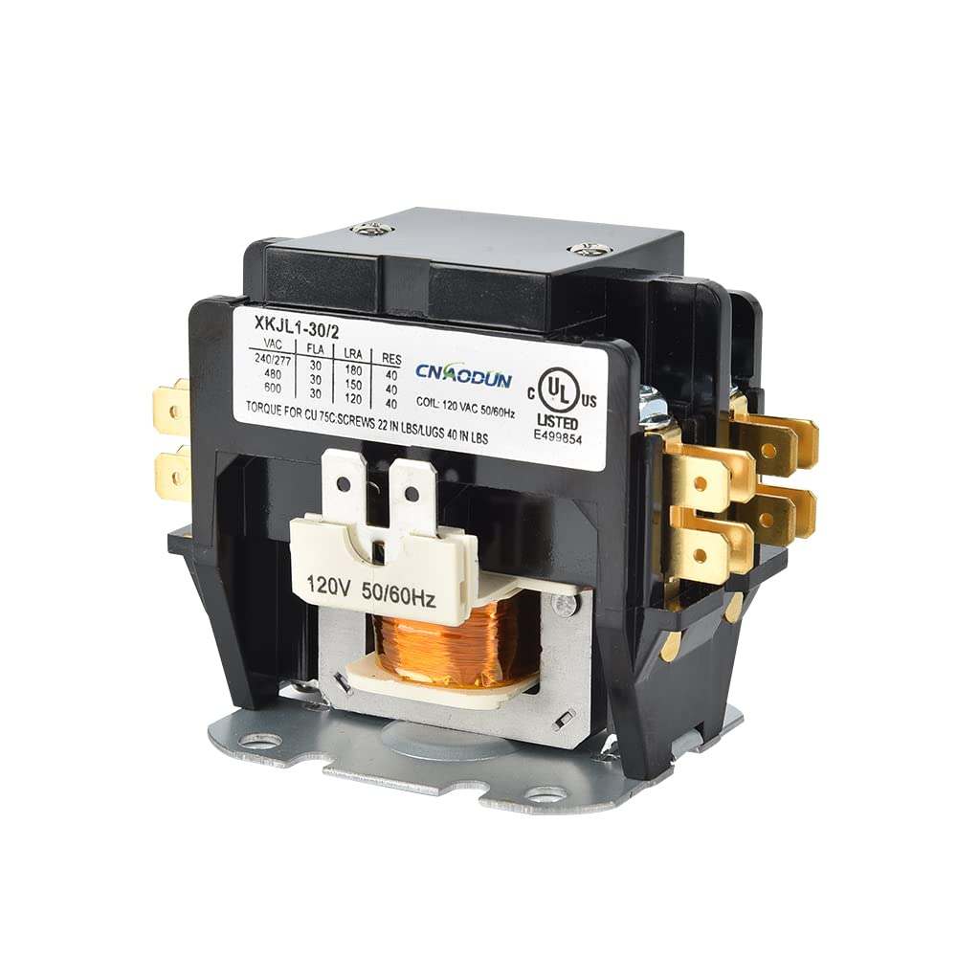
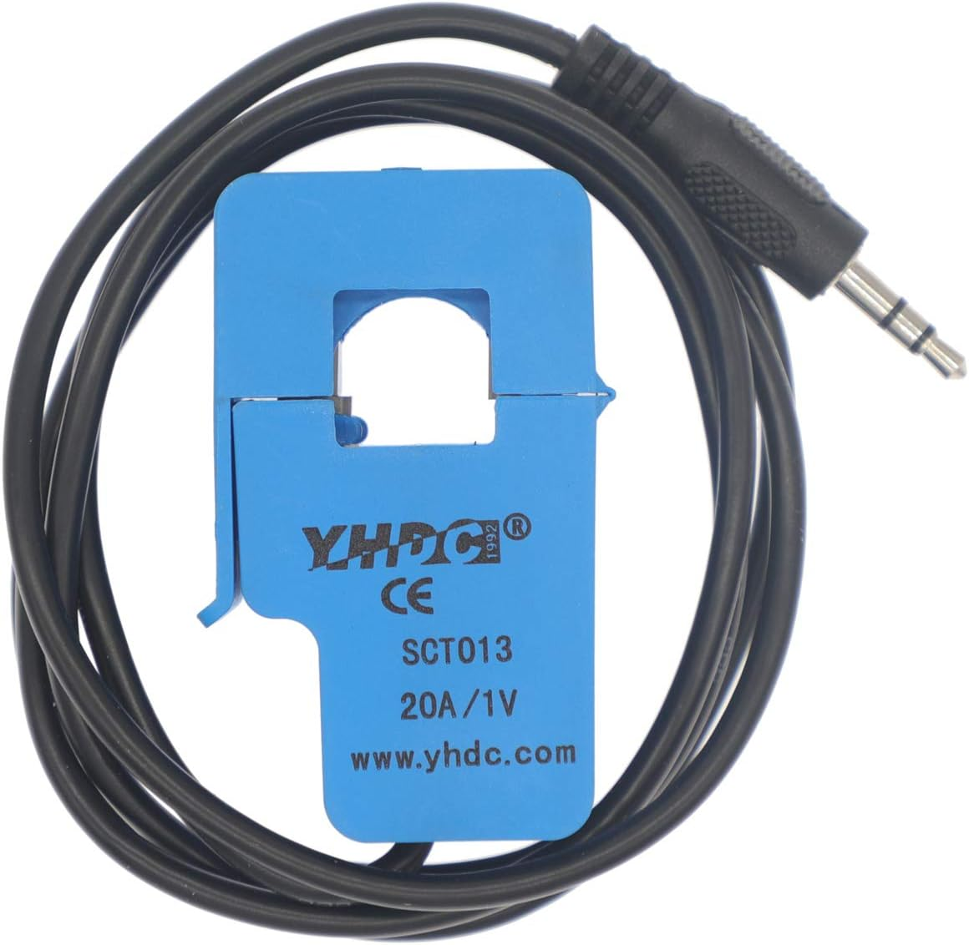
Start:
When Current Meter 1 reads high current, or On Switch Pushed:
5 ->50ms- 1,2,3 ->250ms- 5 -> 500ms- 4
Stop:
1,2,3,4
6 Relay Board
Single Pole Contactor
Double Pole Contactor
Tripple Pole Contactor
Arduino Nano
ADS1115 ADC
2 - SCT013 20A 1V Current Transformer

Slide 11
Software
Arduino Nano (Don’t need anything fancy and had a couple lying around)
#include <Wire.h>
#include <Adafruit_ADS1X15.h>
#include <LiquidCrystal_I2C.h>
Adafruit_ADS1115 ads;
LiquidCrystal_I2C lcd(0x27, 16, 2); //16 columns, 2 rows
// Current measurement constants
const float FACTOR = 20; // 20A/1Vfrom the CT
const float multiplier = 0.00005;
// Digital pin assignments
const int startPin = 6;
const int l1Pin = 5;
const int l2Pin = 4;
const int contactor1Pin = 3;
const int contactor2Pin = 2;
const int emergencyStart = 7;
const int digital_ground = 8;
void setup() {
// I2C Voltmeter setup
Serial.begin(9600);
ads.setGain(GAIN_FOUR); // +/- 1.024V, 1 bit = 0.5mV
ads.begin();
// Set up the digital pins as outputs
pinMode(startPin, OUTPUT);
pinMode(l1Pin, OUTPUT);
pinMode(l2Pin, OUTPUT);
pinMode(contactor1Pin, OUTPUT);
pinMode(contactor2Pin, OUTPUT);
pinMode(digital_ground, OUTPUT);
// Initialize the output states
digitalWrite(startPin, LOW);
digitalWrite(l1Pin, LOW);
digitalWrite(l2Pin, LOW);
digitalWrite(contactor1Pin, LOW);
digitalWrite(contactor2Pin, LOW);
digitalWrite(digital_ground, LOW);
pinMode(emergencyStart, INPUT_PULLUP);
// Initialize the LCD display
lcd.init();
lcd.backlight();
lcd.setCursor(0, 0);
lcd.print("Current (A): ");
}
void loop() {
while ((ads.readADC_Differential_0_1() * multiplier * FACTOR) < .5) {
if (digitalRead(emergencyStart) == LOW) {
startMotor();
while (true) {
lcd.setCursor(0, 1);
lcd.print(getcurrent_RUN());
delay(500);
}
}
lcd.setCursor(0, 1);
lcd.print(0.00);
}
startMotor();
float Current = getcurrent_RUN();
while (Current > 1)
{
Current = getcurrent_RUN();
lcd.setCursor(0, 1);
lcd.print(Current);
}
stopMotor();
delay(3000);
}
void startMotor() {
digitalWrite(startPin, HIGH);
delay(50);
digitalWrite(l1Pin, HIGH);
digitalWrite(l2Pin, HIGH);
digitalWrite(contactor1Pin, HIGH);
delay(250);
digitalWrite(startPin, LOW);
delay(500);
digitalWrite(contactor2Pin, HIGH);
}
void stopMotor() {
digitalWrite(l1Pin, LOW);
digitalWrite(l2Pin, LOW);
digitalWrite(contactor1Pin, LOW);
digitalWrite(contactor2Pin, LOW);
}
// Function to measure and calculate the run current
float getcurrent_RUN() {
float voltage;
float current;
float sum = 0;
long time_check = millis();
int counter = 0;
// Measure current for 1 second
while (millis() - time_check < 1000) {
voltage = ads.readADC_Differential_2_3() * multiplier;
current = voltage * FACTOR;
sum += sq(current);
counter++;
} // Calculate RMS current
current = sqrt(sum / counter);
return current;
}

Slide 12
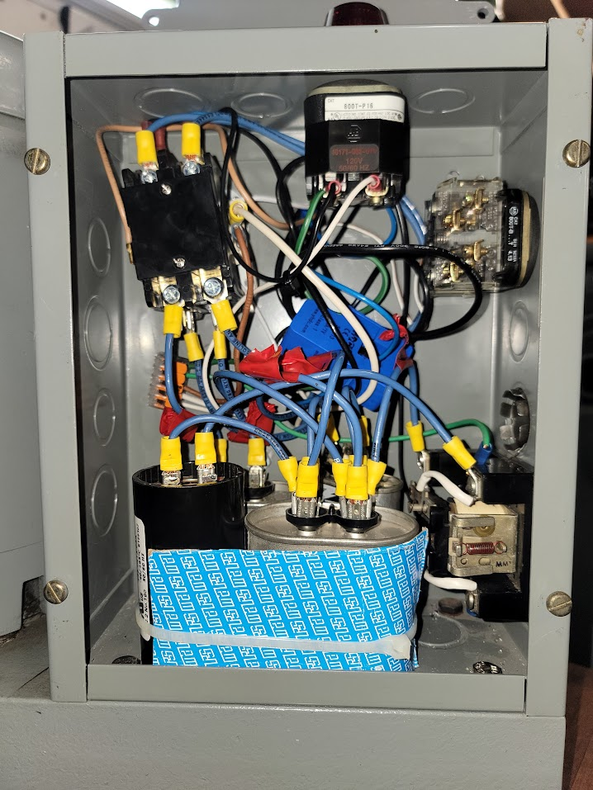
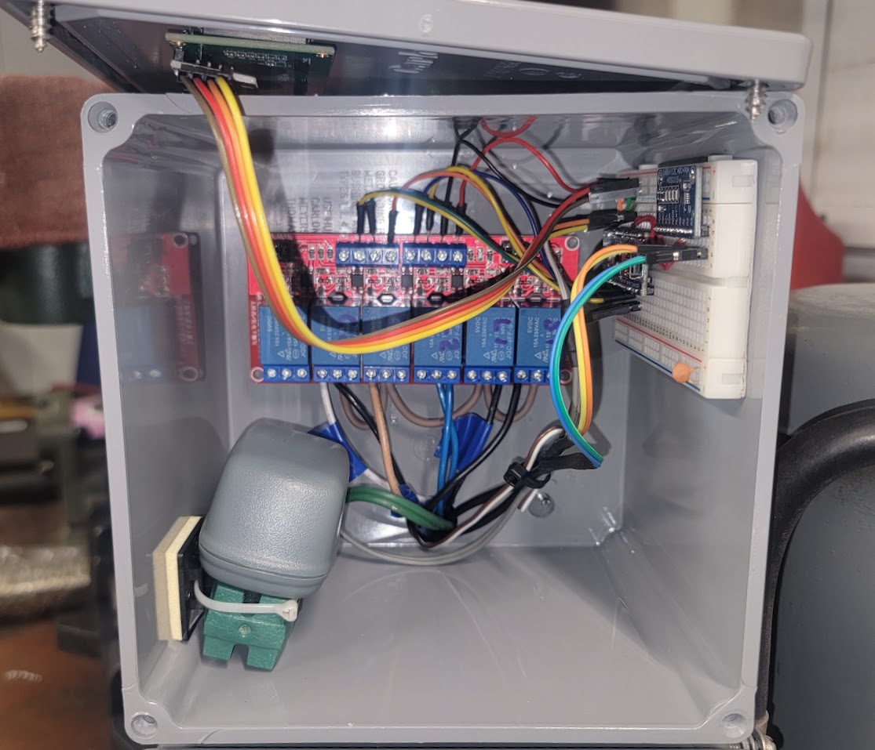
Internal Photos

Slide 13
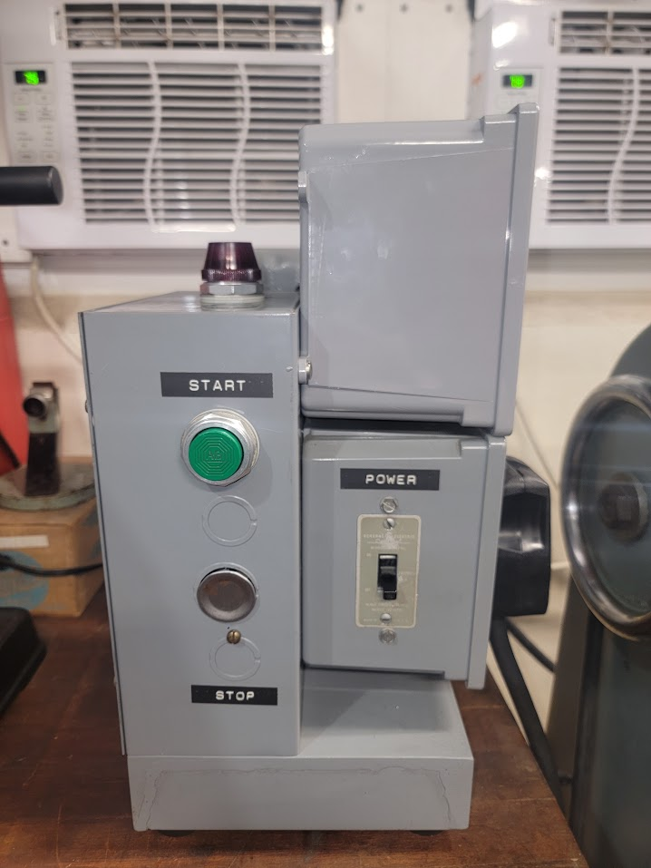
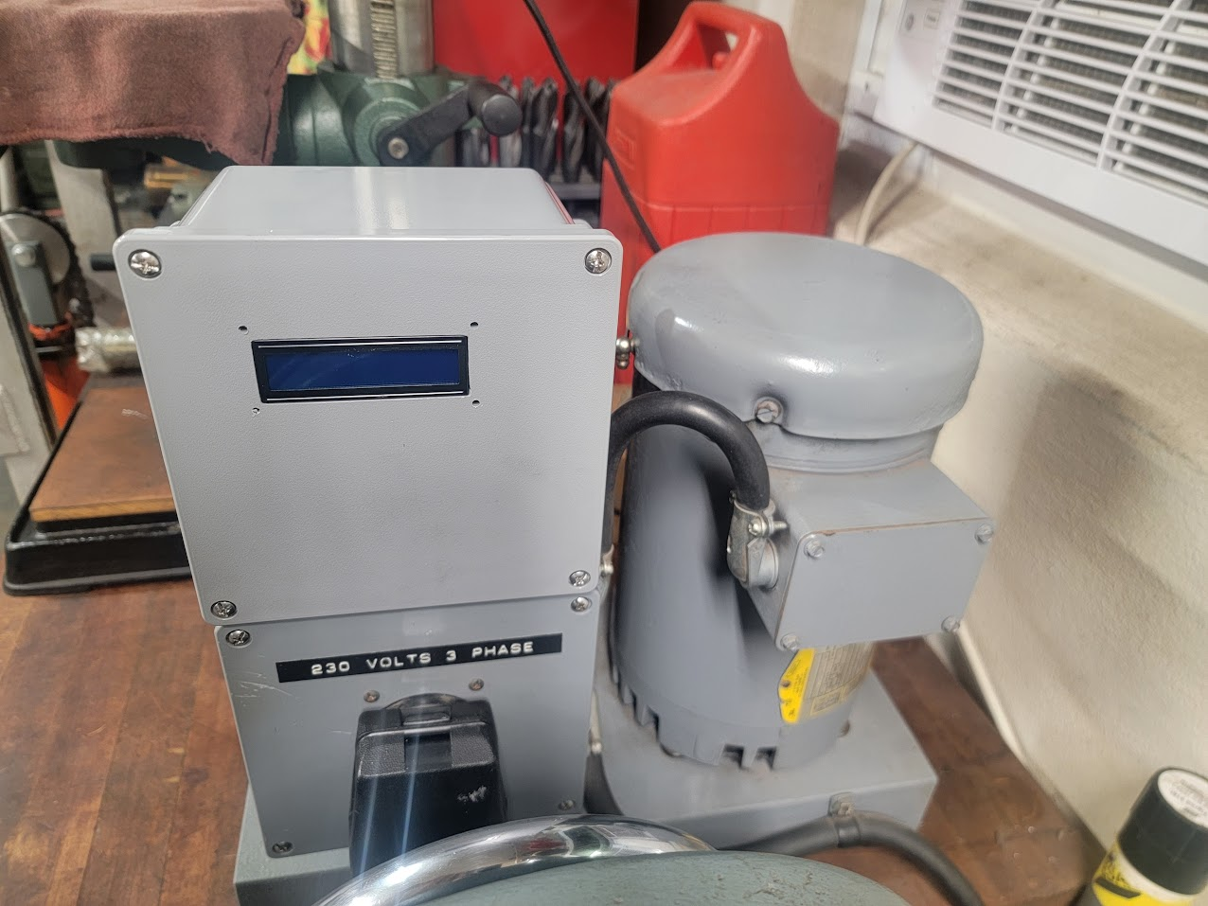
External Photos
Control Electronics
Arduino
Relay Board
ADC
AC/DC Converter
Main Compartment
Capacitors
Start Contactor
Main power Contactor
Indicator light
Start Switch
Output Side
2 Pole Toggle Switch with O/L heater
Dryer Plug
3 Pole Output Contactor
Idler Motor

Slide 14
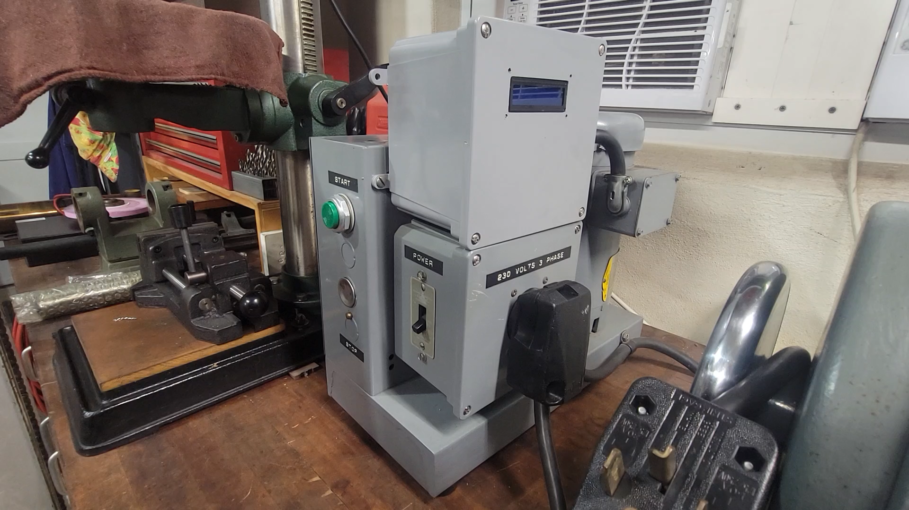

Slide 15
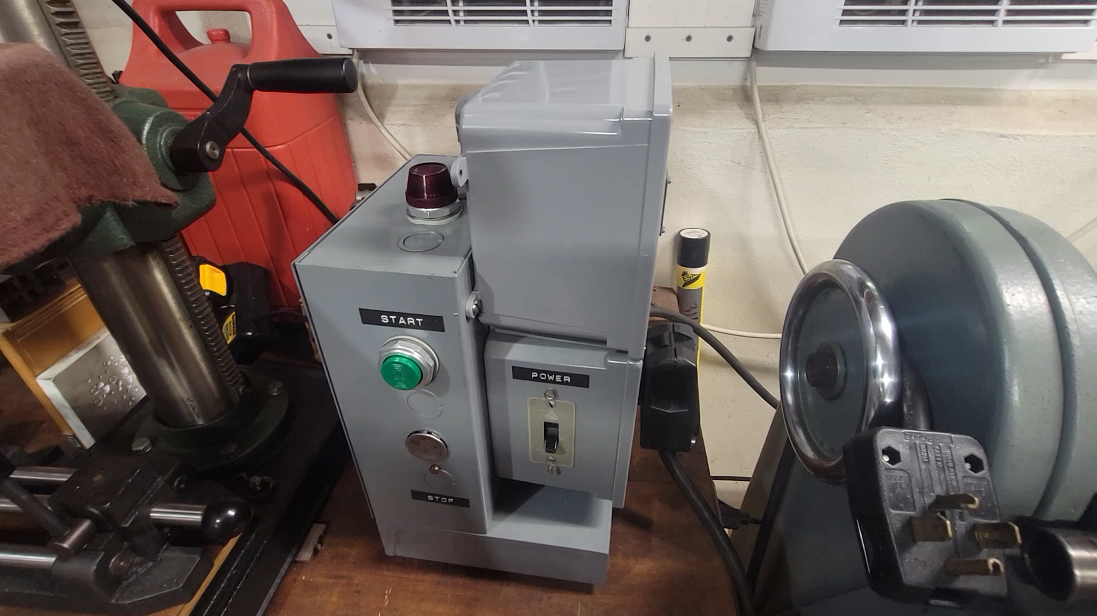

Slide 16
Evaluating Performance
Do not own differential 400V 100x probes for obvious reasons
Wrote Matlab Script to measure using standard 10x probes
Connect to Oscilloscope over WIFI with NIVISA
Request sampling rate, data length, etc
Clear registers for three channels
Request Data
Process the data into usable time and voltages
Fit as sinusoids to find phase and amplitude
Plot (loop with some optimizations to get auto updating plot every second)
No Load

Slide 17
Evaluating Performance
Shaper – 1.7A
Shaper and Bridgeport together - 3.74A
Voltage Sags Under Load!

Slide 18
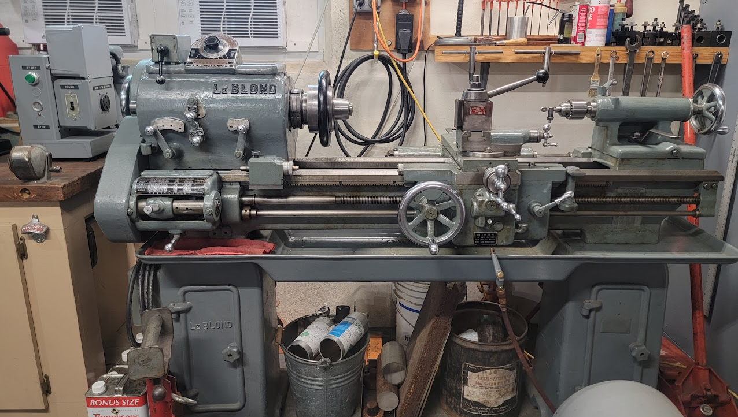
Conclusion
Been working for a month or so now with no issues
Oversized all components to eventually replace the 2HP idler with a 7HP one
Put it all into a GitHub

